Slide 1
Strength of Materials
Module 3 – Beam
(shear force & Bending moment)
Dr. G.Venkatachalam
Professor / SMEC
VIT Chennai Campus
Chennai

Slide 2

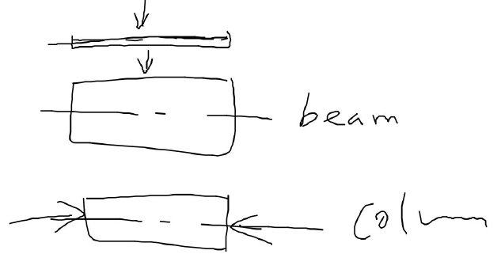
Different one-D structures
Tensile Load - parallel to the axis of the structure
Module 1
Bar
Load - perpendicular to the axis of the structure
Compressive Load - parallel to the axis of the structure
Module 7

Slide 3
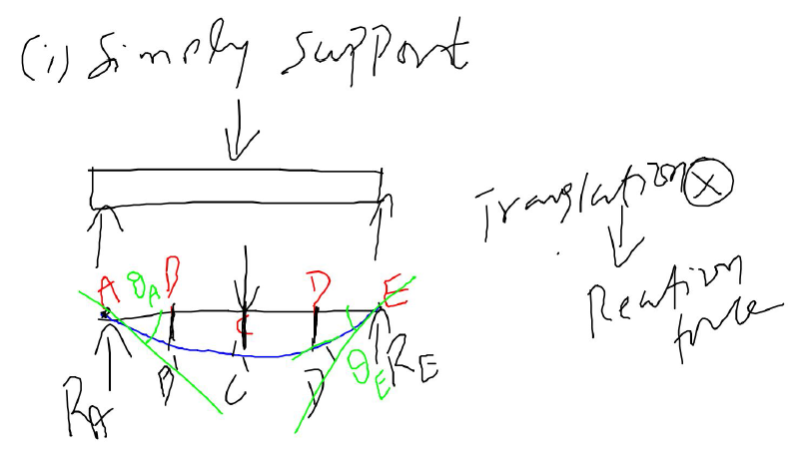
Types of support

Slide 4
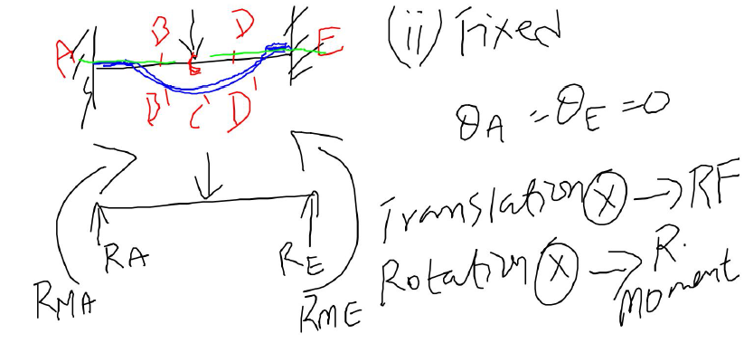

Slide 5
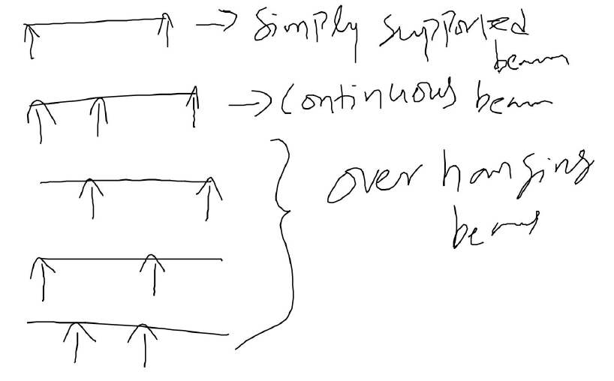
Types of beam – based on simply support

Slide 6
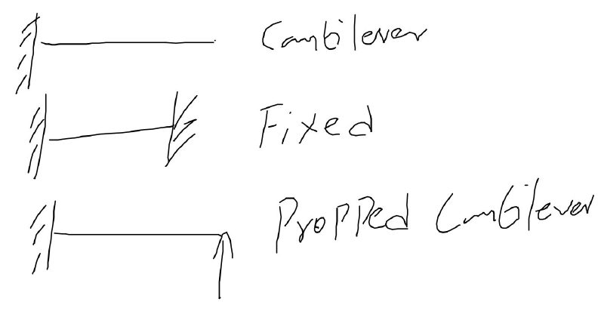
Types of beam – based on fixed support

Slide 7
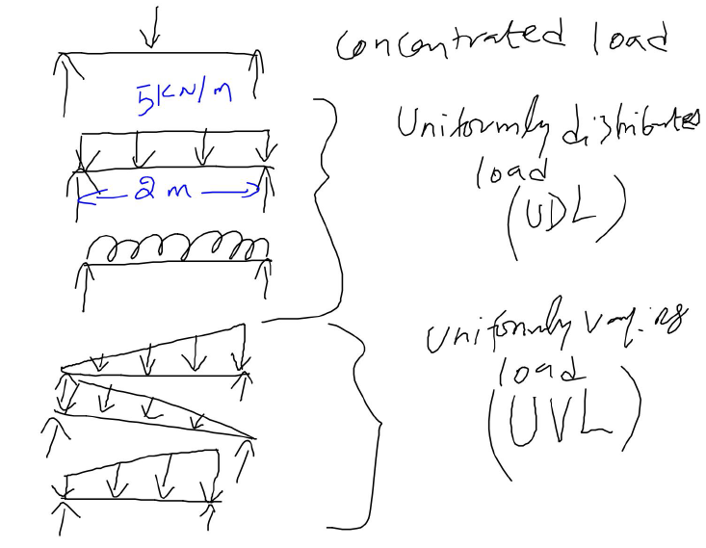
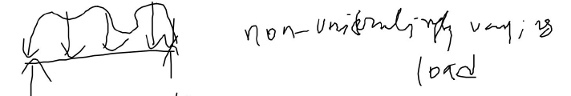
Types of Load

Slide 8
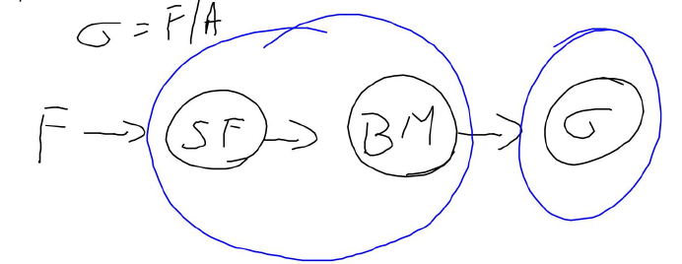
How stress is calculated in bar structure
How stress is calculated in beam structure

Slide 9
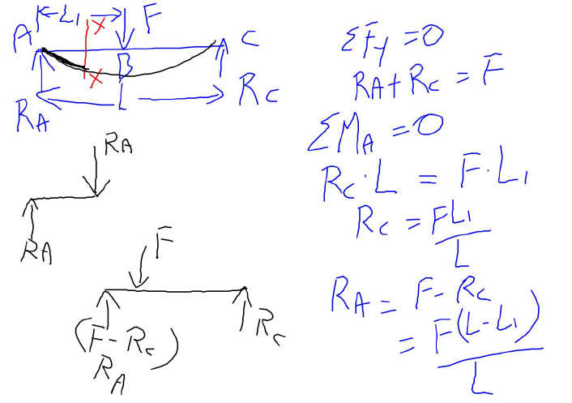
How shear force is developed in beam due to applied force ‘F’???

Slide 10
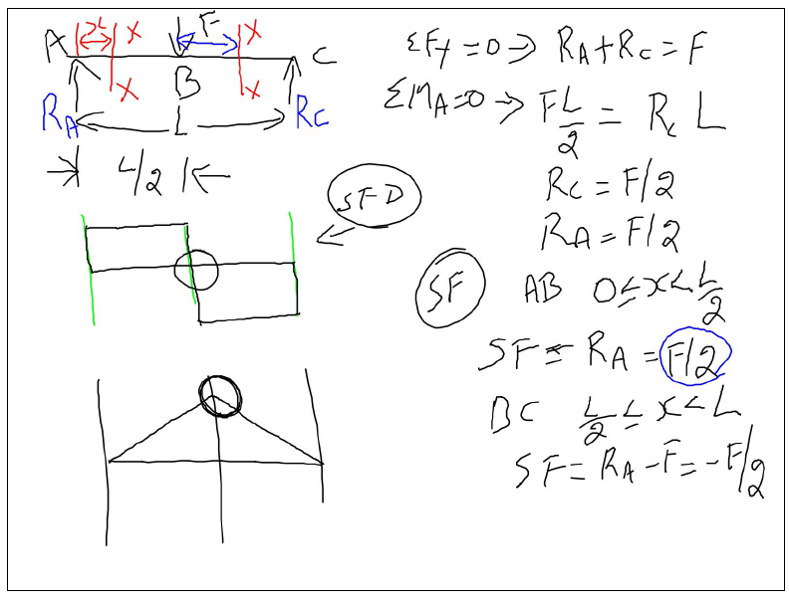
Simply supported beam with a point load ‘F’ at middle

Slide 11
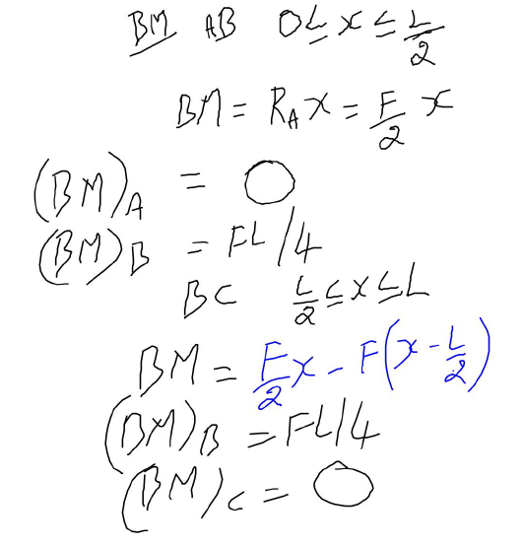
SFD – shear force diagram
BMD – bending moment diagram

Slide 12
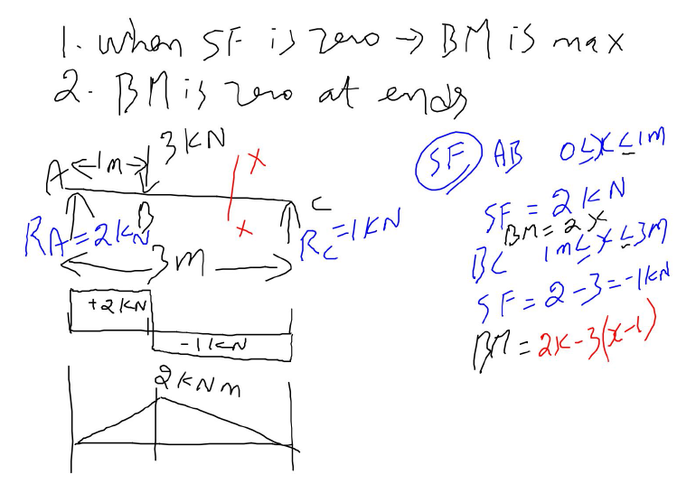
Valid only for simply supported beam

Slide 13
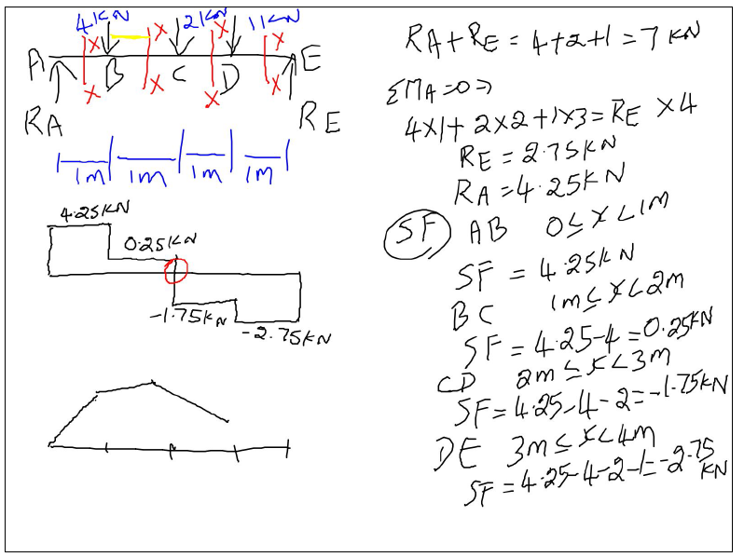
Beam with more than one point load

Slide 14
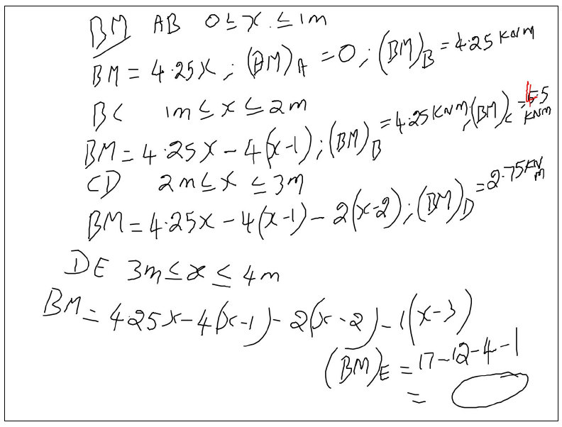

Slide 15
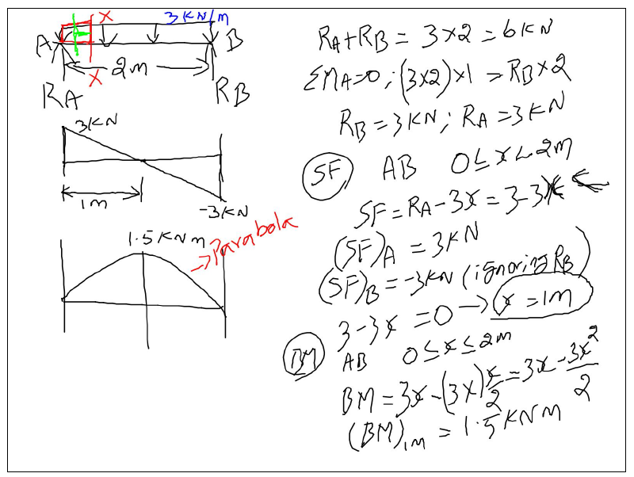
Beam with uniformly distributed load (UDL)

Slide 16
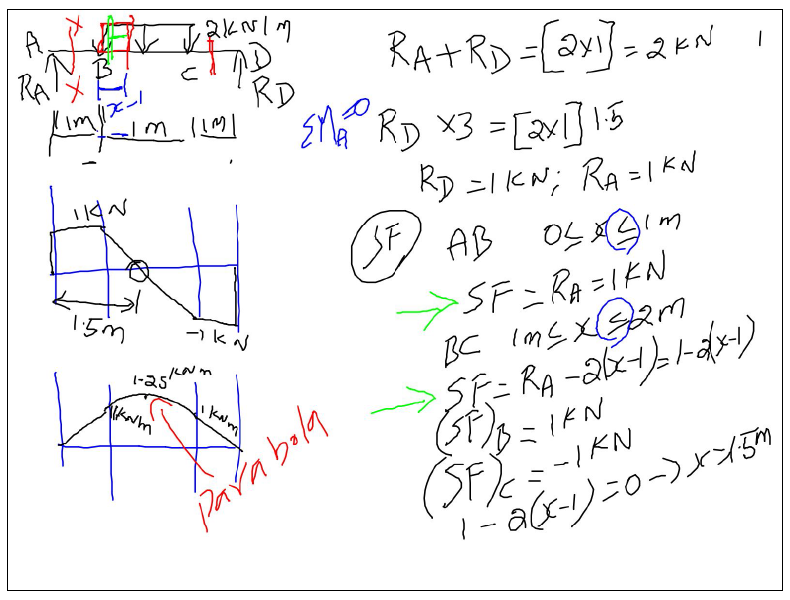

Slide 17
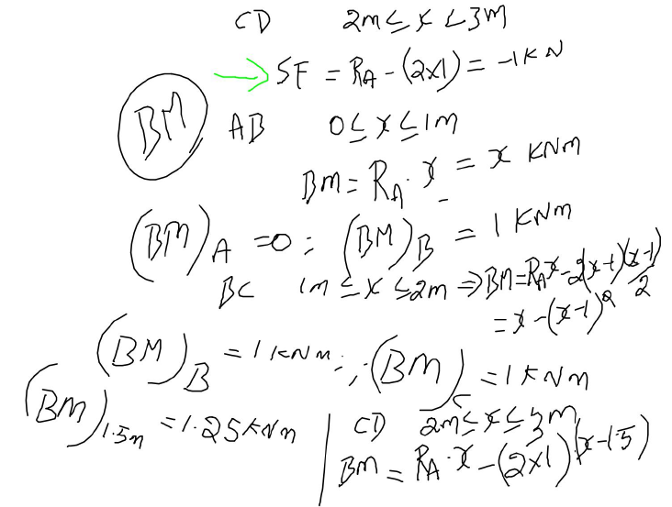

Slide 18
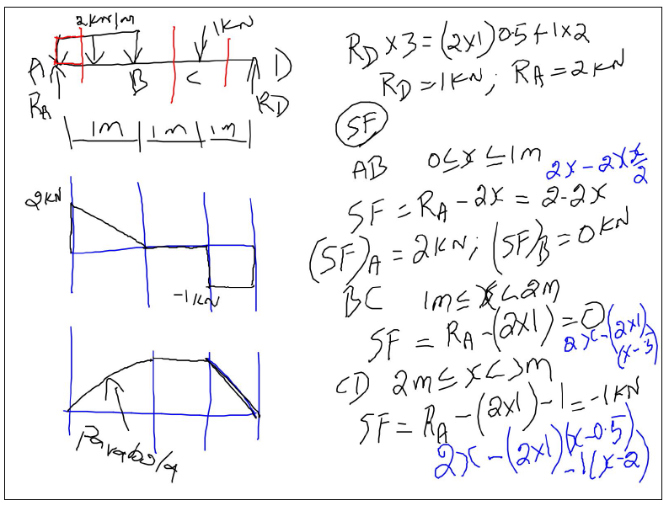
Beam with uniformly distributed load (UDL) + Point load

Slide 19
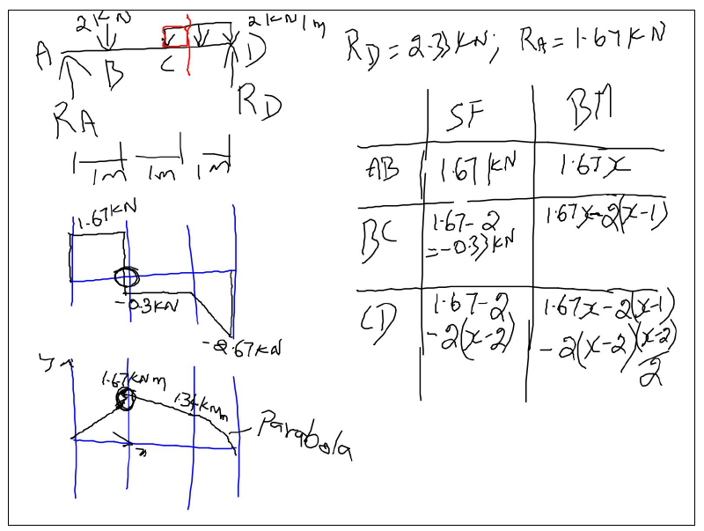

Slide 20
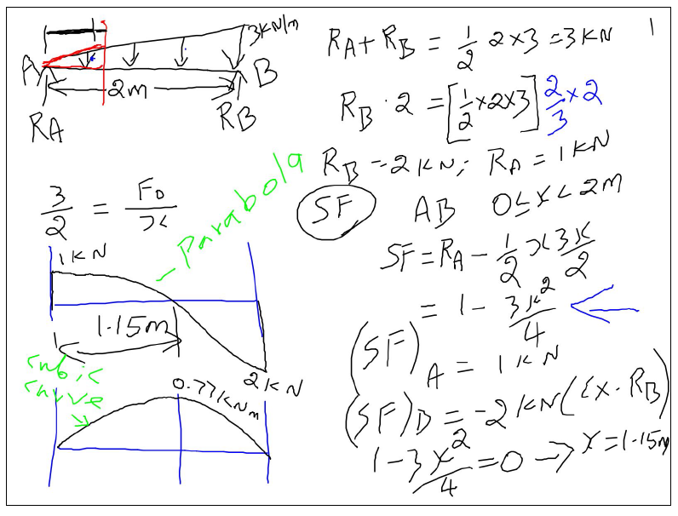
Beam with uniformly varying load (UVL)

Slide 21
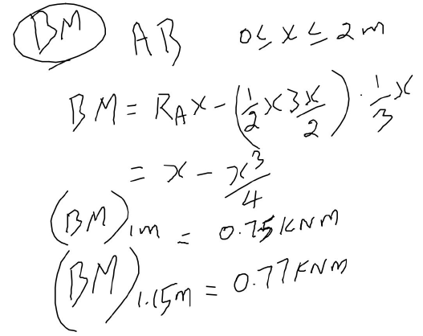

Slide 22
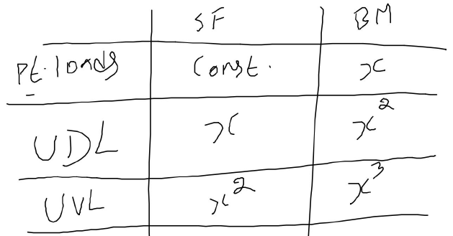
Variation of shear force and bending moment for different load regions

Slide 23
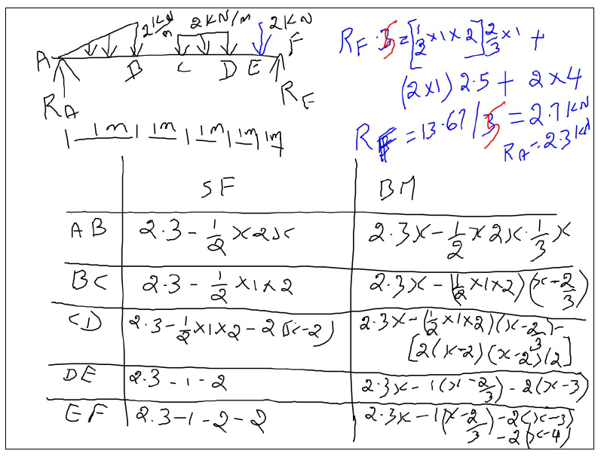
Beam with point load + UDL + UVL

Slide 24
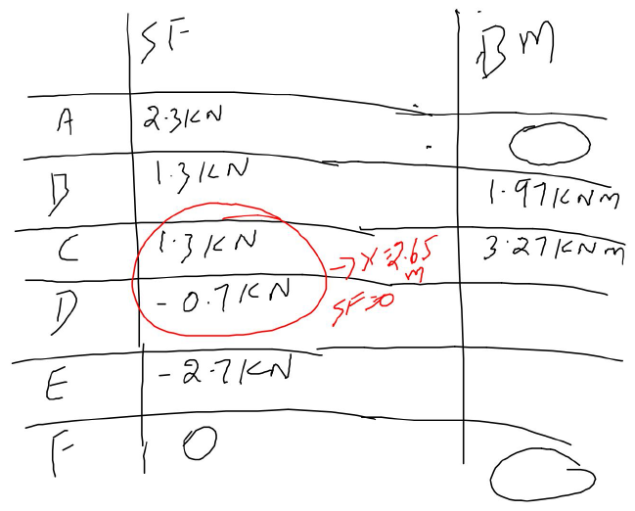

Slide 25
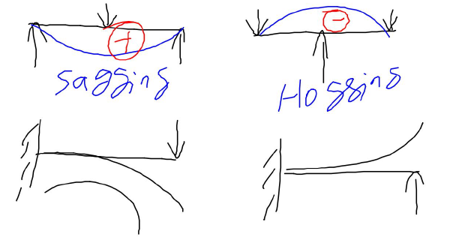

Slide 26
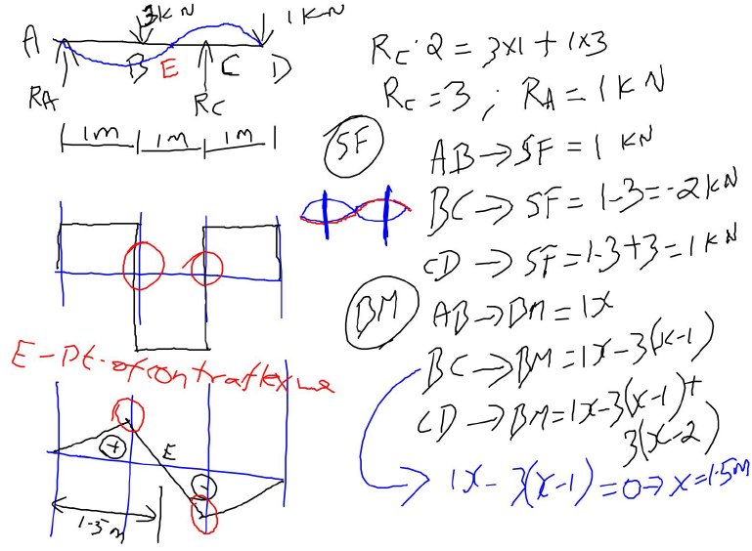
Overhanging beam
Point of contraflexure – BM is zero (or) changes its sign

Slide 27
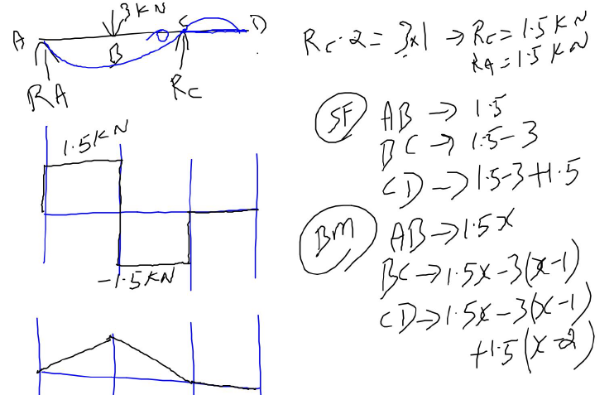

Slide 28
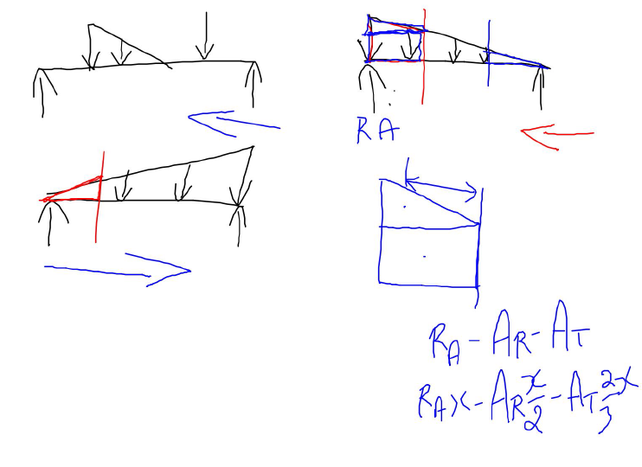
How to solve – beam with different loadings??

Slide 29
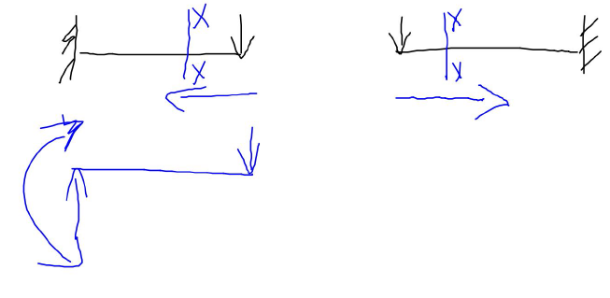
How to solve – cantilever beam??

Slide 30
Thank You

